Slide 1
Threads, Thread management & Resource Management

Slide 2
Algorithms, Programs, and Processes
Idea
Execution Engine
Files
Files
Algorithm
Files
Status
Stack
Source
Program
Binary
Program
Data
Other
Resources
Process

Slide 3
Process manager responsibilities
Process creation and termination
Thread creation and termination
Process synchronization
Resource allocation
Protection & security
Implementing address space

Slide 4
Implementing the Process Abstraction
P_{i} CPU
P_{j} CPU
P_{k} CPU
Ideal Abstraction:
As if using an
Actual machine
…
P_{i} Executable
Memory
P_{j} Executable
Memory
P_{k} Executable
Memory
OS interface
OS Address
Space
CPU
ALU
P_{i} Address
Space
P_{k} Address
Space
Machine Executable Memory
Control
Unit
…
P_{j} Address
Space
Notes:
Classic process vs modern process
Modern process - process supplies the execution framework in which thread execute
Modern process - several musicians (threads) share a single studio to work together on a piece

Slide 5
Modern Processes and Threads
Thrd_{j} in P_{i}
Thrd_{k} in P_{i}
…
P_{i} CPU
…
…
OS interface
…
Notes:
Classic process case: base thread is running/abstract machine is running & abstract machine quits/base thread stops

Slide 6
Processes and Threads
Threads Threads are schedulable activities attached to processes. The aim of having multiple threads of execution is : To maximize degree of concurrent execution between operations To enable the overlap of computation with input and output To enable concurrent processing on multiprocessors.

Slide 7
Reasons to use threads
Enables parallelism (web server) with blocking system calls
Threads are faster to create and destroy then processes
Natural for multiple cores
Easy programming model
Tanenbaum, Modern Operating Systems 3 e, (c) 2008 Prentice-Hall, Inc. All rights reserved. 0-13-6006639

Slide 8
Divide classic process:
Process is an infrastructure in which execution takes place – address space + resources
Thread is a program in execution within a process context – each thread has its own stack
Stack
Data
Thread
Thread
Stack
Process
…
Program
Stack
Thread
Operating System

Slide 9
A Process with Multiple Threads
Thread (Execution Engine)
Status
Stack
Files
Files
Files
Status
Stack
Data
Status
Stack
Binary
Program
Other
Resources
Process

Slide 10
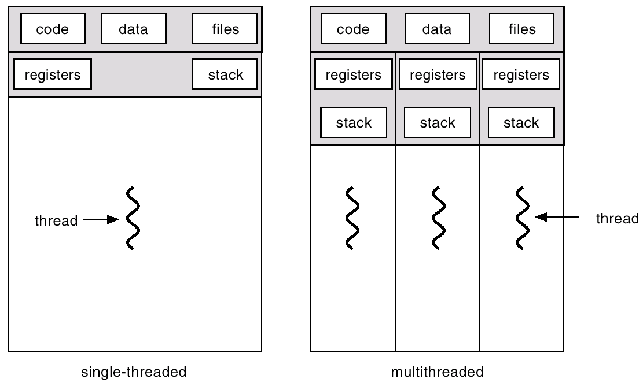

Slide 11
Thread Abstraction
Process Manager has algorithms to control threads and thread descriptor (data structure) to keep track of threads.
Management Tasks
- Create/destroy thread
- Allocate thread-specific resources
- Manage thread context switching
Thread Descriptor
- state
- execution stats
- process (reference to associated process)
- list of related threads
- stack (reference to stack)
- thread-specific resources
Notes:
Context switching includes the task of scheduling
Mosr resources are allocated to associated process - however some are specific to thread

Slide 12
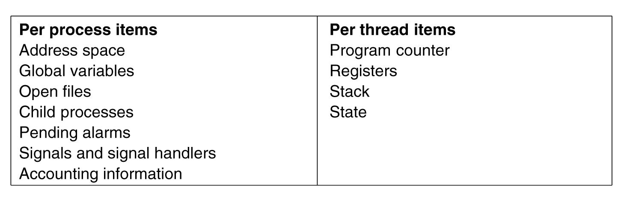
Threads are lightweight
Tanenbaum, Modern Operating Systems 3 e, (c) 2008 Prentice-Hall, Inc. All rights reserved. 0-13-6006639

Slide 13
Threads are like processes
Have same states
Running
Ready
Blocked
Have their own stacks –same as processes
Stacks contain frames for (un-returned) procedure calls
Local variables
Return address to use when procedure comes back
Tanenbaum, Modern Operating Systems 3 e, (c) 2008 Prentice-Hall, Inc. All rights reserved. 0-13-6006639

Slide 14
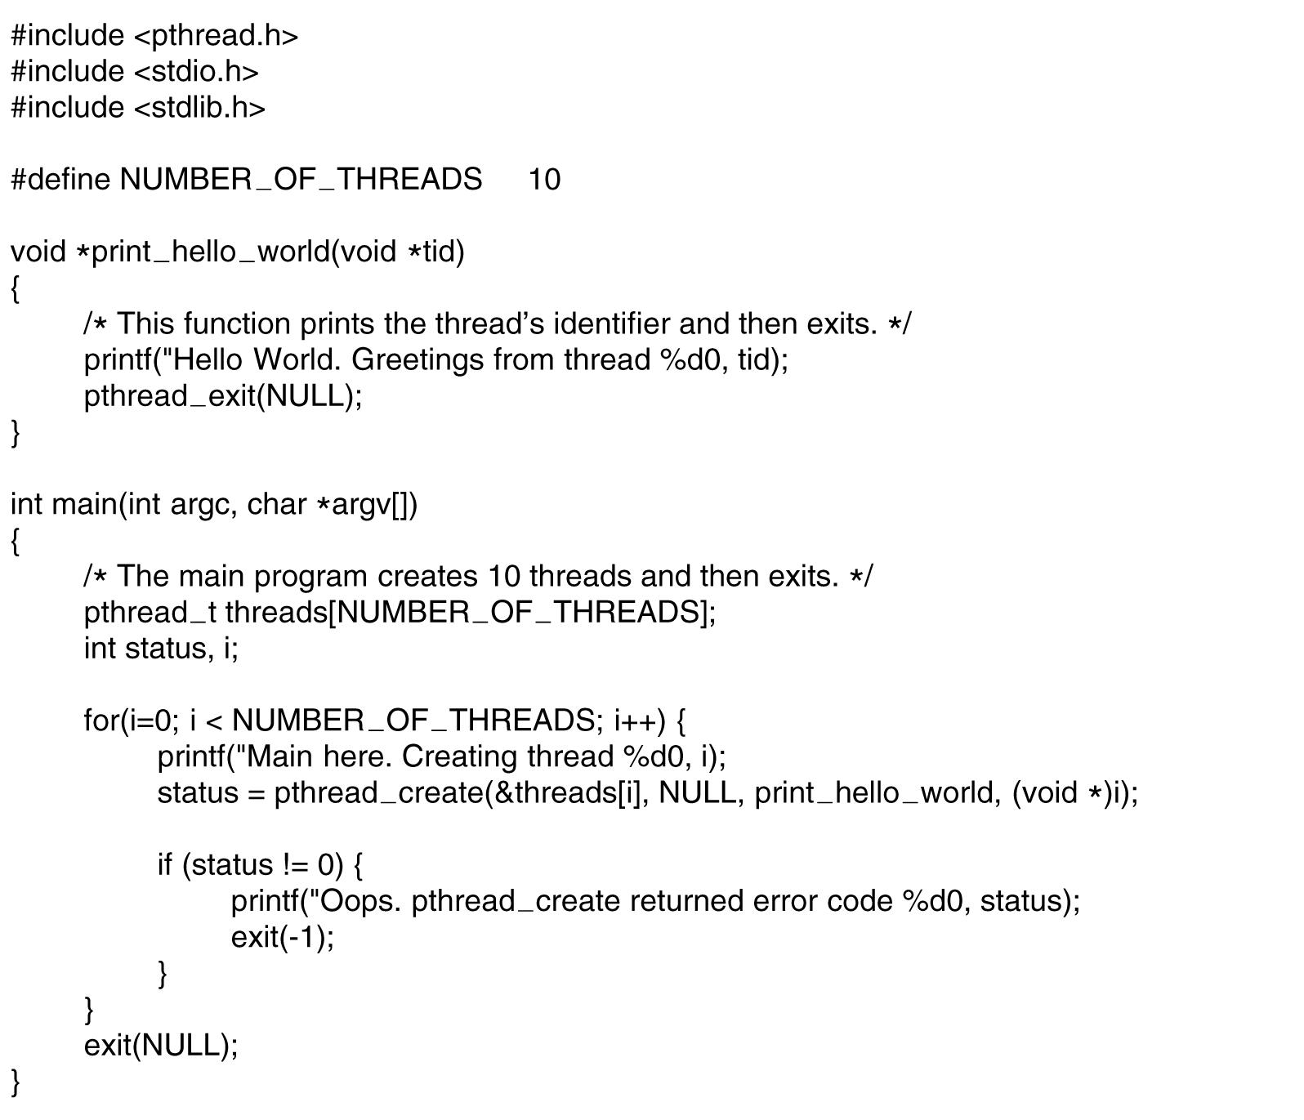
A Pthreads example-”Hello,world”
. . .
.
Tanenbaum, Modern Operating Systems 3 e, (c) 2008 Prentice-Hall, Inc. All rights reserved. 0-13-6006639

Slide 15
Processes and Threads
Processes vs. Threads Threads are “lightweight” processes, processes are expensive to create but threads are easier to create and destroy.

Slide 16
Process & Thread
A Classic process is allocated memory space to hold its image and its resources
Modern operating system
Unit of resource ownership is usually referred to as process
The unit of dispatching is usually referred to as a thread. Thus a thread
Has an execution state
Saves thread context when not running
Has access to memory address space & its resources

Slide 17
Advantage of using threads
It takes less time to create a new thread than a process
It takes less time to terminate a thread than a process
Context switch between two threads within the same process involves lesser time.
Communication overhead is minimized.

Slide 18
There are two broad categories of thread implementation
User Level Threads – thread libraries
Kernel Level Threads – system calls
In ULT, kernel is not aware of the existence of threads
In KLT, all thread management is done by kernel. There is no thread library

Slide 19
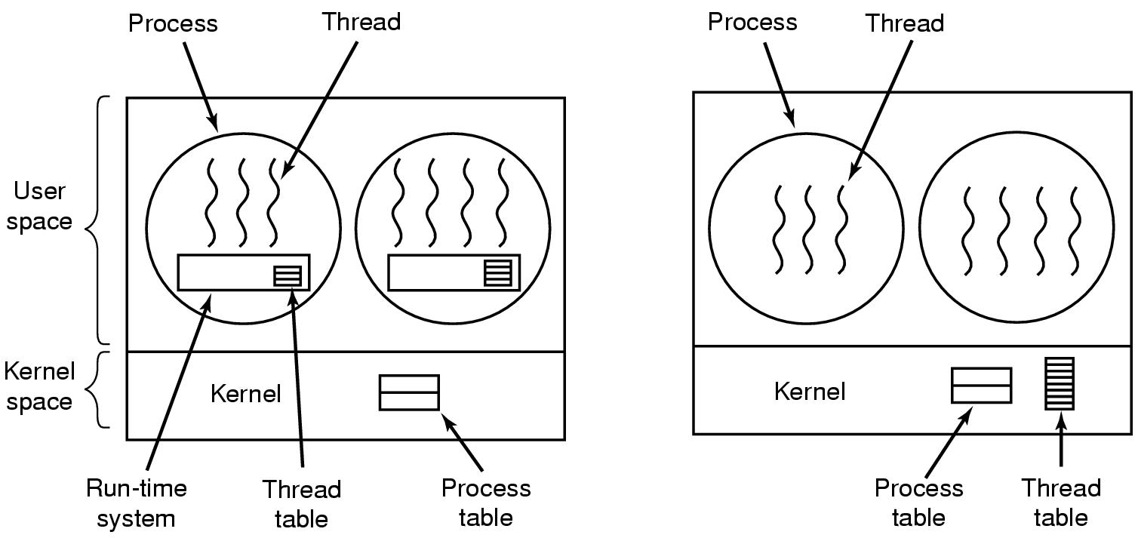
Implementing Threads in User Space
(a) A user-level threads package. (b) A threads package managed by the kernel.
Tanenbaum, Modern Operating Systems 3 e, (c) 2008 Prentice-Hall, Inc. All rights reserved. 0-13-6006639

Slide 20
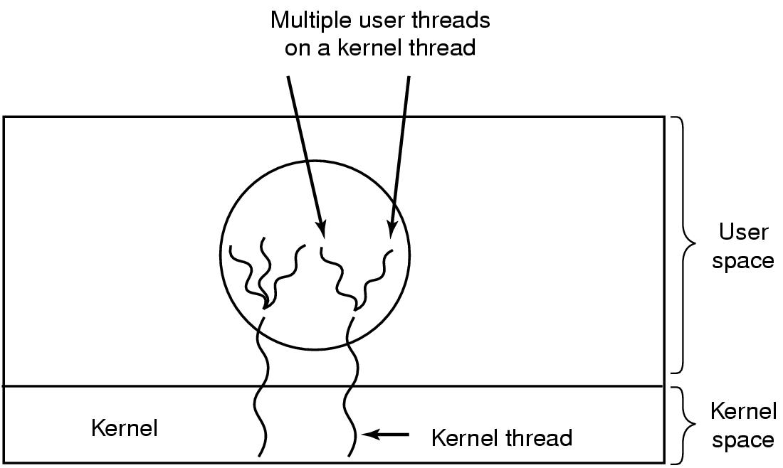
Hybrid approach
Multiplex user-level threads onto kernel level threads
Tanenbaum, Modern Operating Systems 3 e, (c) 2008 Prentice-Hall, Inc. All rights reserved. 0-13-6006639

Slide 21
Hybrid
Kernel is aware of kernel threads only
User level threads are scheduled, created destroyed independently of kernel thread
Programmer determines how many user level and how many kernel level threads to use
Tanenbaum, Modern Operating Systems 3 e, (c) 2008 Prentice-Hall, Inc. All rights reserved. 0-13-6006639

Slide 22
How Linux actually implemented user level threads!
In the kernel, fork is actually implemented by a clone system call.
clone allows you to explicitly specify which parts of the new process are copied into the new process, and which parts are shared between the two processes.
This may seem a bit strange at first, but allows us to easily implement threads with one very simple interface.

Slide 23
Clone ( ) System Call
Thread
clone(CLONE_VM | CLONE_FS | CLONE_FILES |
CLONE_SIGHAND, 0);
• Process with fork( )
clone(SIGCHLD, 0);
Process with vfork( )
clone(CLONE_VFORK | CLONE_VM | SIGCHLD, 0);

Slide 24
While fork copies all of the attributes we mentioned above, imagine if everything was copied for the new process except for the memory. This means the parent and child share the same memory, which includes program code and data.
This hybrid child is called a thread.

Slide 25
User level thread implementation!
Threads have a number of advantages over where you might use fork
Separate processes can not see each others memory. They can only communicate with each other via other system calls.
Threads however, share the same memory. So you have the advantage of multiple processes, with the expense of having to use system calls to communicate between them.
The problem that this raises is that threads can very easily step on each others toes. One thread might increment a variable, and another may decrease it without informing the first thread. These type of problems are called concurrency problems and they are many and varied.

Slide 26
Pthreads
a POSIX standard (IEEE 1003.1c) API for thread creation and synchronization.
API specifies behavior of the thread library, implementation is up to development of the library.
Common in UNIX operating systems.

Slide 27
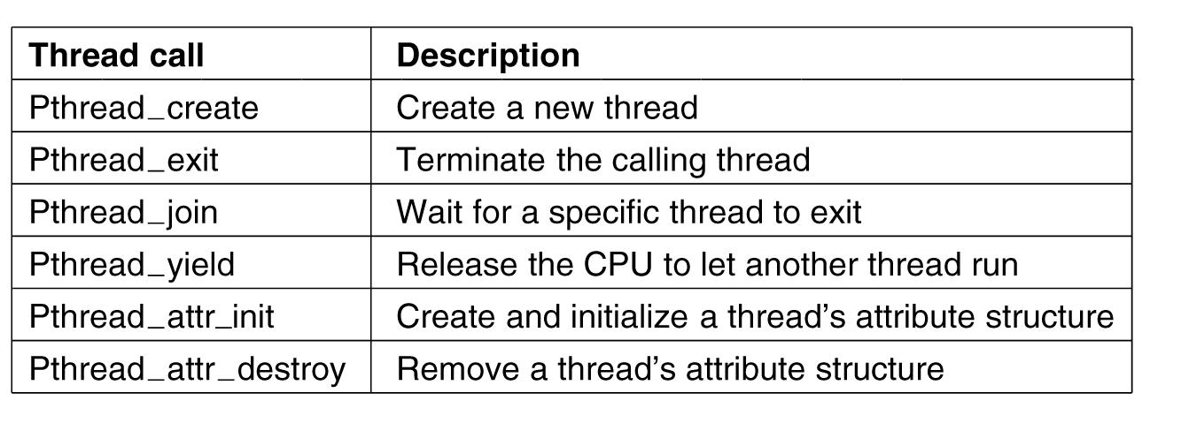
POSIX Threads (Pthreads)
Pthreads are IEEE Unix standard library calls
Tanenbaum, Modern Operating Systems 3 e, (c) 2008 Prentice-Hall, Inc. All rights reserved. 0-13-6006639

Slide 28
Summary : Process and Threads
Process: encompasses
Unit of dispatching: process is an execution path through one or more programs set of threads (computational entities)
execution may be interleaved with other processes
Unit of resource ownership: process is allocated a virtual address space to hold the process image
Thread: Dynamic object representing an execution path and computational state.
threads have their own computational state: PC, stack, user registers and private data
Remaining resources are shared amongst threads in a process

Slide 29
Resources
Resource: Anything that a process can request and then become blocked because that thing is not available.
Resource Descriptors
- Internal resource name
- Total Units
- Available Units
- List of available units
- List of Blocked processes
Notes:
Mechanism = generic part of resource manager (like base class in OOP)
Policy = resource-specific behavior
Resource descriptor (data structure)

Slide 30
Process, Thread, and Resource Management
Thread
Abstraction
Process
Abstraction
Generic
Resource
Manager
Multiprogramming
Other
…
Primary
Memory
Abstract
Resources
Processor

Slide 31
Resources
R = {R_{j} | 0 ≤ j < m} = resource types
C = {c_{j} ≥ 0 | ∀ R_{j}∈R (0 ≤ j < m)} = units of R_{j} available
Reusable resource: After a unit of the resource has been allocated, it must ultimately be released back to the system. E.g., CPU, primary memory, disk space, … The maximum value for c_{j} is the number of units of that resource
Consumable resource: There is no need to release a resource after it has been acquired. E.g., a message, input data, … Notice that c_{j} is unbounded.
Notes:
M - different types of resources
Each can have multiple units - C
Processes can request variable # units of resources

Slide 32
Using the Model
There is a resource manager, Mgr(R_{j}) for every R_{j}
Process p_{i} can request units of R_{j} if it is currently running
p_{i} can only request n_{i} ≤ c_{j} units of reusable R_{j}
p_{i} can request unbounded # of units of consumable R_{j}
Mgr(R_{j}) can allocate units of R_{j} to p_{i}
request
Mgr(R_{j})
Process
allocate
Notes:
Once allocation is determined, RM will:
1. Update OS data structures (process and resource descriptors)
2. Allocate x units to process
3. Remove process from blocked pool
4. Change p state to ready

Slide 33
A Generic Resource Manager
Resource Manager
Policy
Blocked Processes
Process
Process
Process
request()
Process
release()
Resource Pool

